Slide 1
Name: Swapnil Ghosh
Group: A2
Roll: 001911001067
TASK 11

Slide 2
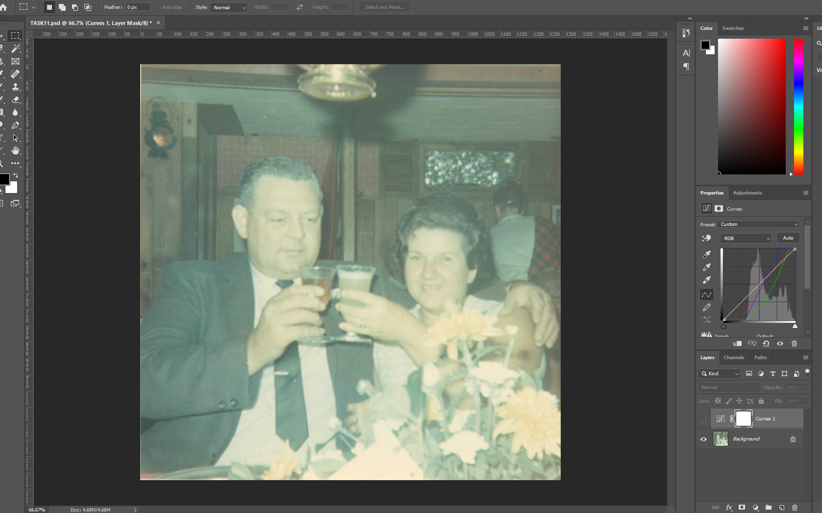
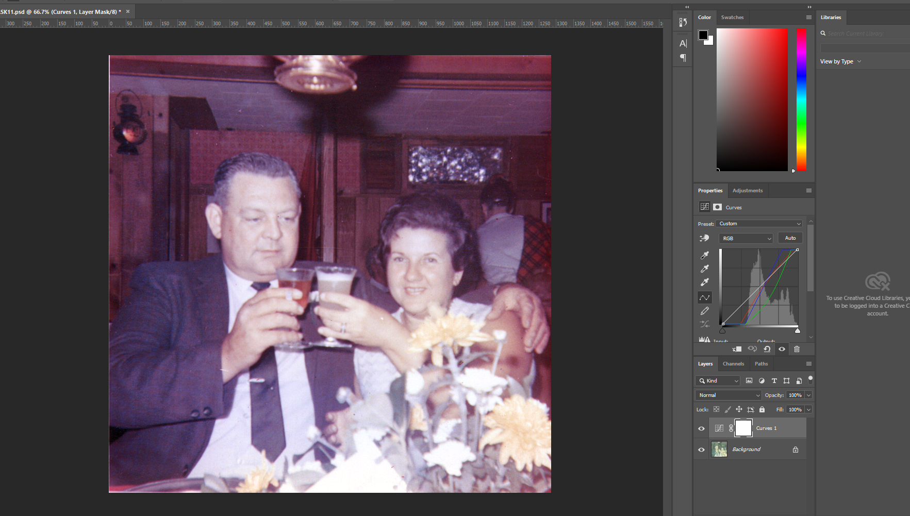
Step-1) Opened file CHEERS.TIF in Photoshop.
Step-2) Create a new adjustment layer by choosing Curves function.
Step-3) Used a white point by clicking on the white eye-dropper tool on the white triangular object in the bottom center.
Step-4) Used a black point by clicking the black eye-dropper tool on the dark area just below the man’s elbow.
Step-5) To remove greenish tint, we choose Green channel and move the middle point of the curve
5 to 6 increments to the right and down.
Step-6) To remove bluish tint, we choose Red channel and move the middle point of the curve 5 to 6
increments to the up and to the left.
Step-7) To Remove white border around the image we used Crop tool.

